Slide 1
National Conference on Emerging Technologies on Computing and Communication (NETC²) 2019
Technical Session: 7 Paper ID : 703
Data transmission to a portable speaker using Li-Fi technology and solar charger for smart phones.
Pavan Teja B Diwakar Babu
Pawan V
Suraj R Bellad
Dept. of CSE
patb16cs@cmrit.ac.in/pawv16cs@cmrit.ac.in/surb16cs@cmrit.ac.in

Slide 2
Abstract
The main aim of the paper is to demonstrate the application of Li-Fi (Light Fidelity) by operating a speaker.
We narrow this paper down to find a substitute to WiFi .We use Li-Fi to pass data to a portable speaker instead of other conventional methods i.e. (Bluetooth, WiFi).
The high data transfer, throughput, data security makes Li-Fi more advantageous over WiFi.

Slide 3
Since mobile is a daily driver for almost everyone we take this research one step further by providing a portable charger for mobile phones using solar panel .
The mobile is charged simultaneously when the speaker is switched on.

Slide 4
Paper Outline
Introduction
Related Work
Design/Framework
Implementation
Results/Testing
Conclusion
References

Slide 5
Introduction
The main concern of this paper is to communicate with a speaker via LiFi using a LED light.
Li-Fi provides highly reliable and secure data transfer as light cannot penetrate walls.
Therefore not accessible to those who are not in the range and thus the speaker can be controlled only by people in the range.

Slide 6
When compared to Wi-Fi the data throughput and data security is relatively high for Li-Fi. We use energy sources like electricity to power or charge devices which are non-renewable resources and expensive. Thus using solar energy to charge the smart phones will minimize the usage of electricity.

Slide 7
Related Work
Li-Fi is wireless communication technology, which utilizes light to transmit data and the data transmission depends on the position of devices. The term was first introduced by Harald Haas during a 2011 TEDGlobal talk in Edinburgh.
Li-Fi is a visible light communications system that is capable of transmitting data at high speeds over the visible light, ultraviolet, and infrared spectrums.

Slide 8
In terms of its end use, the technology is similar to Wi-Fi - the key technical difference being that Wifi uses radio frequency to transmit data.
Using light to transmit data allows Li-Fi to offer several advantages, most notably a wider bandwidth channel, the ability to safely function in areas otherwise susceptible to electromagnetic interference and offering higher transmission speeds.
‹#›

Slide 9
We see a potential in Li-Fi because of its benefits stated below:
i) It prevents Piggybacking -Piggybacking is the intent of getting access of unrestricted WiFi. Li-Fi prevents it as the light cannot penetrate walls and hence restricting the access.
ii) The data being transmitted is not hindered by any radio frequencies thus making it very reliable.
‹#›

Slide 10
iii) The transmission does not create interference in sensitive electronic devices thus making it better to use it in environments like hospitals and aircrafts.
iv)By including all the light-sources around the building we can enable larger area of coverage than a single WiFi router.
v) We need to have a clear line of sight to achieve the same.
‹#›

Slide 11
Framework / Model
Dont disturb this part i’ll upload the circuitary used for implementation

Slide 12
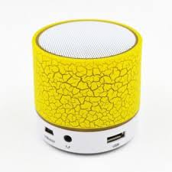
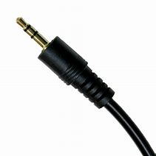
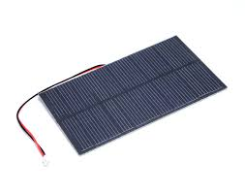
Methodology
components used are:
Portable speaker: used for audio output which is powered using usb.
Audio jack: 3.5mm-used for connecting and transmitting audio from source.
Solar Panel: an array of solar cell with a voltage throughput of 5.5v and 300mA

Slide 13
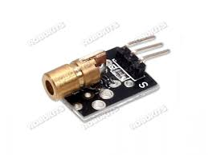

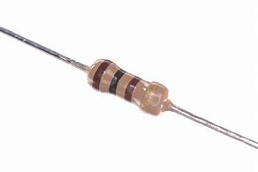
3.Laser module: it consumes 5v and produces a light of wavelength 650nm.
4. Female Aux socket: 3.5mm socket used to connect audio jack.
5. Resistor: 100ohm resistor is used for controlling the flow of current passing through the circuit.

Slide 14
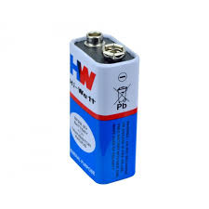

7. Battery: A 9v dc power source is used to power the laser module so as to emit the light on the solar panel.
8.Connector: It is used to connect to the battery to have terminals for connections

Slide 15
Implementation
The solar panel is connected to audio socket.
The input audio signal is sent through audio jack connected to the source.(audio player from smart phone)
Negative end of battery is connected to one terminal of the aux cable.
The positive terminal is connected to a 100ohm resistor in series so as to control the current flow and resistor is connected to positive of laser module.
Negative end of laser module is connected to another terminal of aux cable.

Slide 16
Results and Discussion
Li-Fi has wide range of applications in the field of wireless communication providing reliable data transfer and high rate of transmission up to gigabytes.
Data is transferred with the visible light and is transmitted across the visible light spectrum.
In field of data electronics, it provides ample ways to transfer signals and its relative data to the greatest accuracy and in the most precise way.

Slide 17
Communicating and obtaining data from satellite will be easier than ever before. It will be beneficial for defense services as their data is very confidential and private and LIFI cannot be hacked so data is protected.
Thus Li-Fi is the new renovation in the field of wireless communication.
‹#›

Slide 18
Conclusion and Future Scope
Li-Fi applications can be varied as a results of its key options like directional lighting, energy potency, intrinsic security, high rate capability, signal block by walls and integrated networking capability.
In future applications like VLC (Visible Light Communication) capable small LEDs may be integrated into good device displays and indicator lights, turning them into powerful knowledge transmission ports.
National Conference on Emerging Technologies in Computing and Communication (NETC²) May 17,18 2019
‹#›

Slide 19
References
https://www.ijert.org/future-of-wireless-technology-lifi
http://www.lifi-centre.com/about-li-fi/applications/
Ijarcsms_june_2015_li_fi_anurag_shalabh_asoke_30_06_2015
International Advanced Research Journal in Science, Engineering & Technology (IARJSET) National Conference on Renewable Energy & Environment (NCREE-2015) IMS Engineering College, GhaziabadVol. 2, Issue 1, April 2015 by,Satyendra Kumar Gupta, Anurag Agrawal.
National Conference on Emerging Technologies in Computing and Communication (NETC²) May 17,18 2019
‹#›

